Slide 1


Game Engines 1
Design Patterns for Games
Dr Bryan Duggan
DIT School of Computing
bryan.duggan@dit.ie
@ditcomputing
http://facebook.com/ditschoolofcomputing

Slide 2
Questions we will answer
What are design patterns and why are they important
What problems in games do design patterns address
Examples of design patterns in BGE

Slide 3
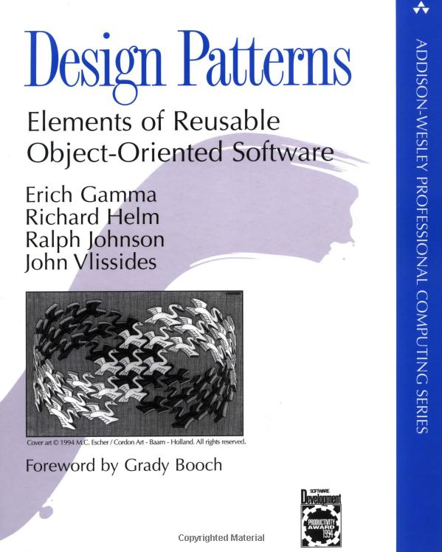
What are design patterns?
A very famous book
Published in 1994
Common solutions to problems in software developmnent
Part 1
The capabilities and pitfalls of object-oriented programming
Part 2
23 classic software design patterns

Slide 4
Principles
Program to an 'interface', not an 'implementation‘
Clients are unaware of the specific types of objects they use, as long as the object adheres to the interface
Clients remain unaware of the classes that implement these objects; clients only know about the abstract class(es) defining the interface
Interfaces lead to dynamic binding and polymorphism (central features of object-oriented programming).
Inheritance is referred to as white-box reuse
The internals of parent classes are often visible to subclasses
Object composition is black-box reuse
No internal details of composed objects need be visible in the code using them
"Because inheritance exposes a subclass to details of its parent's implementation, it's often said that 'inheritance breaks encapsulation'“
Using inheritance is recommended mainly when adding to the functionality of existing components, reusing most of the old code and adding relatively small amounts of new code

Slide 5
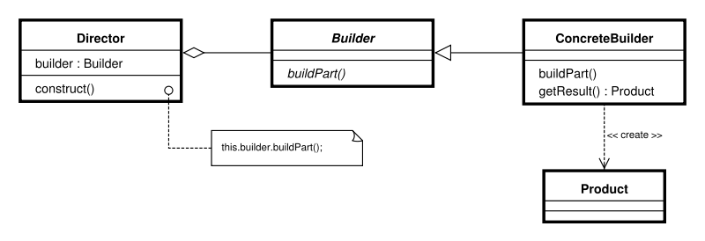
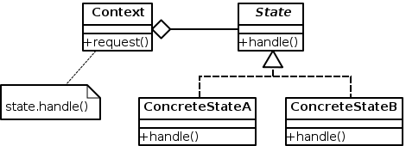
Some examples
Creational
Factory
Prototype
Singleton
Structural
Adapter
Composite
Decorator
Proxy
Behaviorable
Interpreter
Iterator
Observer
State

Slide 6
Some more!
Lazy loading
Loading on demand. Defer initialization of an object until the point at which it is needed
Instancing
Rendering multiple copies of the same mesh in a scene at once
Controller
Update a game objects state based on circumstance

Slide 7
Some goals for BGE (or any other game engine)
Keep track of everything in the scene
Allow game objects to be assembled from components – increase code reuse and flexibility
Allow easy creation of composite objects such as physics objects
Allow lazy loading of game assets
Support instancing
State management of game components

Slide 8
Implemented in BGE
Keep track of everything in the scene
Aggregate design pattern
Game instance is a singleton
Allow game objects to be assembled from components –
Increase code reuse and flexibility without making subclasses
Assemble components in unexpected ways
Use a base class interface GameComponent
Aggregate design pattern
Allow easy creation of composite objects such as physics objects
Creating physics objects is complicated so use PhysicsFactory
Allow lazy loading of game assets
Use the static methods on the Content class
Support instancing
Use the static methods on the Content class
Content caches content items
State management of game components
StateMachine controller
Can be attached to any object
Will cover this in Semester 2

Slide 9
BGE GameComponents
The aggregate design pattern
Game Component
Initialise()
Update(timeDelta)
Draw()
Cleanup()
Attach(GameComponent c)
list<GameComponent> children
0..*

Slide 10
Component Based Games Engines
Everything in BGE is a component
Most things extend GameComponent
virtual bool Initialise();
virtual void Update(float timeDelta);
virtual void Draw();
virtual void Cleanup();
GameComponent’s keep track of a list of children components & parent component
std::list<std::shared_ptr<GameComponent>> children;
This is known as the aggregate design pattern

Slide 11
The base class GameComponent
Holds a list of GameComponent children references
Use Attach() to add something to the list.
Calls Initialise, Update and Draw on all children
All subclasses do their own work first then
Must call the base class member function so that the children get Initialised, Updated and Drawn!
Are these depth first or breadth first?
This means that the scene is a graph of objects each contained by a parent object
The parent object in BGE is the Game instance

Slide 12
bool GameComponent::Initialise()
{
// Initialise all the children
std::list<std::shared_ptr<GameComponent>>::iterator it = children.begin();
while (it != children.end())
{
(*it ++)->initialised = (*it)->Initialise();
}
return true;
}

Slide 13
This is used..
To implement a scene graph
Children objects have their world transforms multiplied by the parent world transform
Also to implement components & controllers
Children objects have their Initialise Update and Draw functions called
Children objects can update the world transform of the parent (Controllers)
Children objects can use the world transform of the parent (E.g Model or VectorDrawer)

Slide 14
3 ugly problems
Lots of duplication!
Controllers and models don’t need a world transform
They should simply use the transforms of the things they are attached to
Lots of copying of unnecessary copying of state around the place
Lots of complicated rules to remember
from_self, to_parent, from_parent etc.

Slide 15
How it should be?
Separate GameObject class
For things with a world transform
Separate GameComponent class
For things without a world transform
Controllers are just a special type of GameComponent
This is how Unity does it
And the next version of BGE (check out the BGENE branch
Doesn’t compile yet
I'm still not sure the best way to do this. I am open to suggestions or a pull request

Slide 16
The PhysicsFactory
Factories
Hide the implementation details required to construct a complex object
Don’t need lots of parameters and lots of constructors
Technically a factory should be an interface that returns instances of a base class
Subclasses of the factory should create different subclasses of the base class type
I simplify things in BGE, there is just a PhysicsFactory class
Just encapsulates all the code for making physics things

Slide 17
AbstractFactory

Slide 18
In PhysicsFactory
shared_ptr<PhysicsController> CreateBox(float width, float height, float depth, glm::vec3 pos, glm::quat quat);
shared_ptr<PhysicsController> CreateSphere(float radius, glm::vec3 pos, glm::quat quat);
shared_ptr<PhysicsController> CreateCylinder(float radius, float height, glm::vec3 pos, glm::quat quat);
shared_ptr<PhysicsController> CreateVehicle(glm::vec3 pos);
shared_ptr<PhysicsController> CreateCameraPhysics();
shared_ptr<PhysicsController> CreateGroundPhysics();
shared_ptr<PhysicsController> CreateFromModel(string name, glm::vec3 pos, glm::quat quat, glm::vec3 scale = glm::vec3(1));
void CreateWall(glm::vec3 startAt, float width, float height, float blockWidth = 5, float blockHeight = 5, float blockDepth = 5);
shared_ptr<PhysicsController> CreateRandomObject(glm::vec3 point, glm::quat q);

Slide 19
Example: Creating a box
shared_ptr<PhysicsController> PhysicsFactory::CreateBox(float width, float height, float depth, glm::vec3 pos, glm::quat quat)
{
// Create the shape
btCollisionShape * boxShape = new btBoxShape(btVector3(width, height, depth) * 0.50);
btScalar mass = 1;
btVector3 boxInertia(0,0,0);
boxShape->calculateLocalInertia(mass,boxInertia);
// This is a container for the box model
shared_ptr<Box> box = make_shared<Box>(width, height, depth);
box->worldMode = GameComponent::from_child;
box->position = pos;
Game::Instance()->Attach(box);
// Create the rigid body
btDefaultMotionState * boxMotionState = new btDefaultMotionState(btTransform(GLToBtQuat(quat)
,GLToBtVector(pos)));
btRigidBody::btRigidBodyConstructionInfo fallRigidBodyCI(mass, boxMotionState, boxShape, boxInertia);
btRigidBody * body = new btRigidBody(fallRigidBodyCI);
body->setFriction(567);
dynamicsWorld->addRigidBody(body);
// Create the physics component and add it to the box
shared_ptr<PhysicsController> boxController = make_shared<PhysicsController>(PhysicsController(boxShape, body, boxMotionState));
boxController->tag = "Box";
body->setUserPointer(boxController.get());
body->setCollisionFlags(body->getCollisionFlags() | btCollisionObject::CF_CUSTOM_MATERIAL_CALLBACK);
box->Attach(boxController);
return boxController;
}

Slide 20
To use it…
shared_ptr<PhysicsController> box1 = physicsFactory->CreateBox(1,1,4, glm::vec3(5, 5, 0), glm::quat());
From the PhysicsController you can get access to the parent object and all the bullet objects
You could even get the model if you really wanted it

Slide 21
Lazy Loading & Instancing
Inspired by XNA, I created the Content class with static methods for loading stuff:
static shared_ptr<Model> LoadModel(string name, glm::mat4 localTransform = glm::mat4(1));
static FMOD::Sound * LoadSound(string name, bool looped = false);
static GLuint LoadShaderPair(string name);
static GLuint LoadTexture(std::string path);

Slide 22
Cacheing
Content.h:
static map<string, shared_ptr<Model>> models;
static map<string, GLuint> textures;
static map<string, GLuint> shaders;
static map<string, FMOD::Sound * > sounds;
Content.cpp:
map<string, shared_ptr<Model>> Content::models = map<string, shared_ptr<Model>>();
map<string, GLuint> Content::textures = map<string, GLuint>();
map<string, GLuint> Content::shaders = map<string, GLuint>();
map<string, FMOD::Sound*> Content::sounds = map<string, FMOD::Sound*>();

Slide 23
Always check the cache before loading content…
FMOD::Sound * Content::LoadSound(string name, bool looped)
{
// First check to see if it's already loaded and if so, just return it
map<string, FMOD::Sound*>::iterator mit = Content::sounds.find(name);
if (mit != Content::sounds.end())
{
return mit->second;
}
…
…
textures[textureName] = texture;

Slide 24
shared_ptr<Model> Content::LoadModel(string name, glm::mat4 localTransform) {
// First check to see if it's already loaded and if so, just return it
map<string, shared_ptr<Model>>::iterator mit = Content::models.find(name);
if (mit != Content::models.end())
{
return mit->second;
}
…
…
Content::models[name] = model;

Slide 25
GLuint Content::LoadTexture(std::string textureName)
{
// First check to see if it's already loaded and if so, just return it
map<string, GLuint>::iterator it = Content::textures.find(textureName);
if (it != Content::textures.end())
{
return it->second;
}
…
…
textures[textureName] = texture;

Slide 26
Summary
Aggregate
Scene graph
Components
Comtrollers
Singleton
Factory
Instancing
Lazy loading
Caching

